Slide 1
E-Commerce Sales & Promotion Analysis
Analysis of e-commerce sales, user interactions, customer behaviour, product performance, and promotional trends.

Slide 2
PROJECT OVERVIEW AND BUSINESS PROBLEM
Project Overview
This project analyzes e-commerce user activity, product performance, customer behavior, and promotional activity using Excel, SQL, and Power BI. The analysis focuses on identifying activity trends, high-performing products and categories, channel patterns, and promotional activity to generate actionable business insights.
Business Problem
The business needs to understand user activity and purchasing behavior across products, categories, channels, and locations. Without clear analysis, it can be difficult to identify high-performing products, peak days and time of user activity, important activity trends, and the relationship between promotional activity and user engagement.

Slide 3
Project Objectives
Analyze overall user activity and engagement across the e-commerce platform.
Identify high-performing products and categories based on user activity.
Analyze user activity across different channels and locations.
Identify peak days and time of user activity.
Analyze product prices and user scores to identify relevant patterns.
Examine promotional activity and discounts across products.
Generate business insights using Excel, SQL, and Power BI to support data-driven decision-making.

Slide 4
DATASET DESCRIPTION
The e-commerce sales dataset captures customer interactions, product details and sales activity across different dates, channels, and locations. The promotion dataset contains product IDs along with the percentage of discount applied to each product.
Columns of the dataset are:
Promotion dataset
Promotion Id: Unique promotional campaign id.
Date: Date on which the promotional discount was applied.
Discount: Percentage discount offered.
ProductId: Unique product id. (Foreign key linking from sales dataset)

Slide 5
DATASET DESCRIPTION
Sales dataset
user_id: Unique identifier for the user.
user_session: Unique id of user session.
State: US state
User_Score: Segmentation of customer based on user activity.
event_date & Day_of_Week: Date of the event and corresponding day of the week.
event_time, event_hour, & event_timezone: Time of event, hour of event, and reference timezone (UTC).

Slide 6
DATASET DESCRIPTION
Channel: Access platform used by the user (Browser or App).
event_type: Type of user interaction (View, Cart or Purchase).
product_id & category_id: Unique id for products and categories.
category, sub_category1, & sub_category2: Hierarchical classification of products.
brand: Manufacturer or brand name.
price: Price of the item in product.

Slide 7
BUSINESS QUESTIONS
Q .What is the total number of events and unique users recorded?
Q .Which product categories generate the highest user activity?
Q .Which brands and products receive the highest number of events?
Q .Which channels contribute the most to overall user activity?
Q .Which states have the highest user activity?
Q .What is the month-over-month change in user activity?
Q .Which products received promotions, and how did their activity compare with non-promoted products?
Q .Which users interacted with products from more than three different categories and what are those categories?
Q .Which are the top 2 products within each category based on the number of events?
Q . Which users events are higher than the average number of events generated by all users.
Q .Which promoted products had the highest user activity on their promotion dates?
Q .Which days of the week and hour of the day have the highest user activity?
Q .Which category had the highest month-over-month increase in activity?

Slide 8
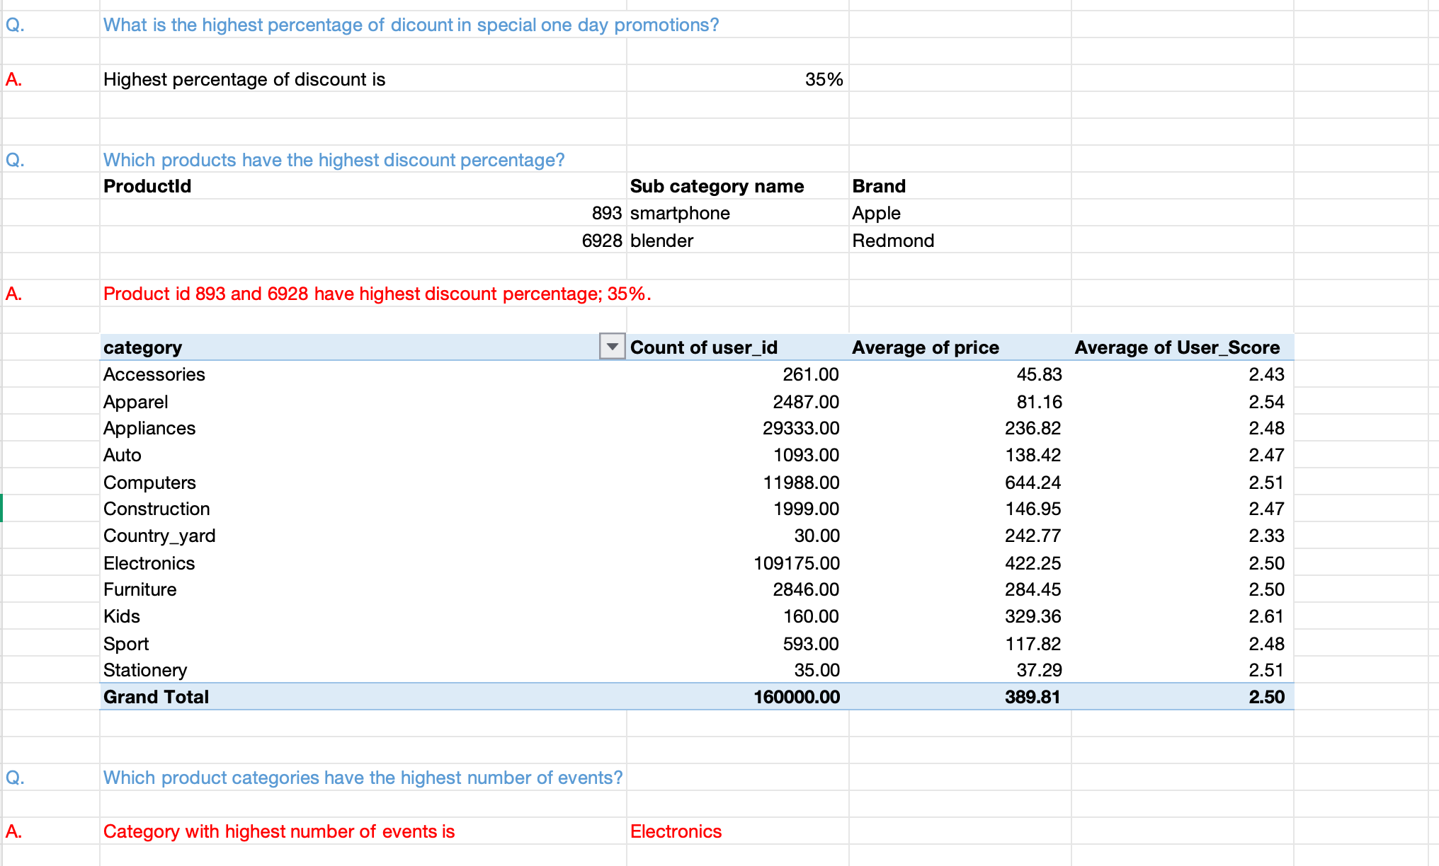
ANALYSIS
EXCEL

Slide 9
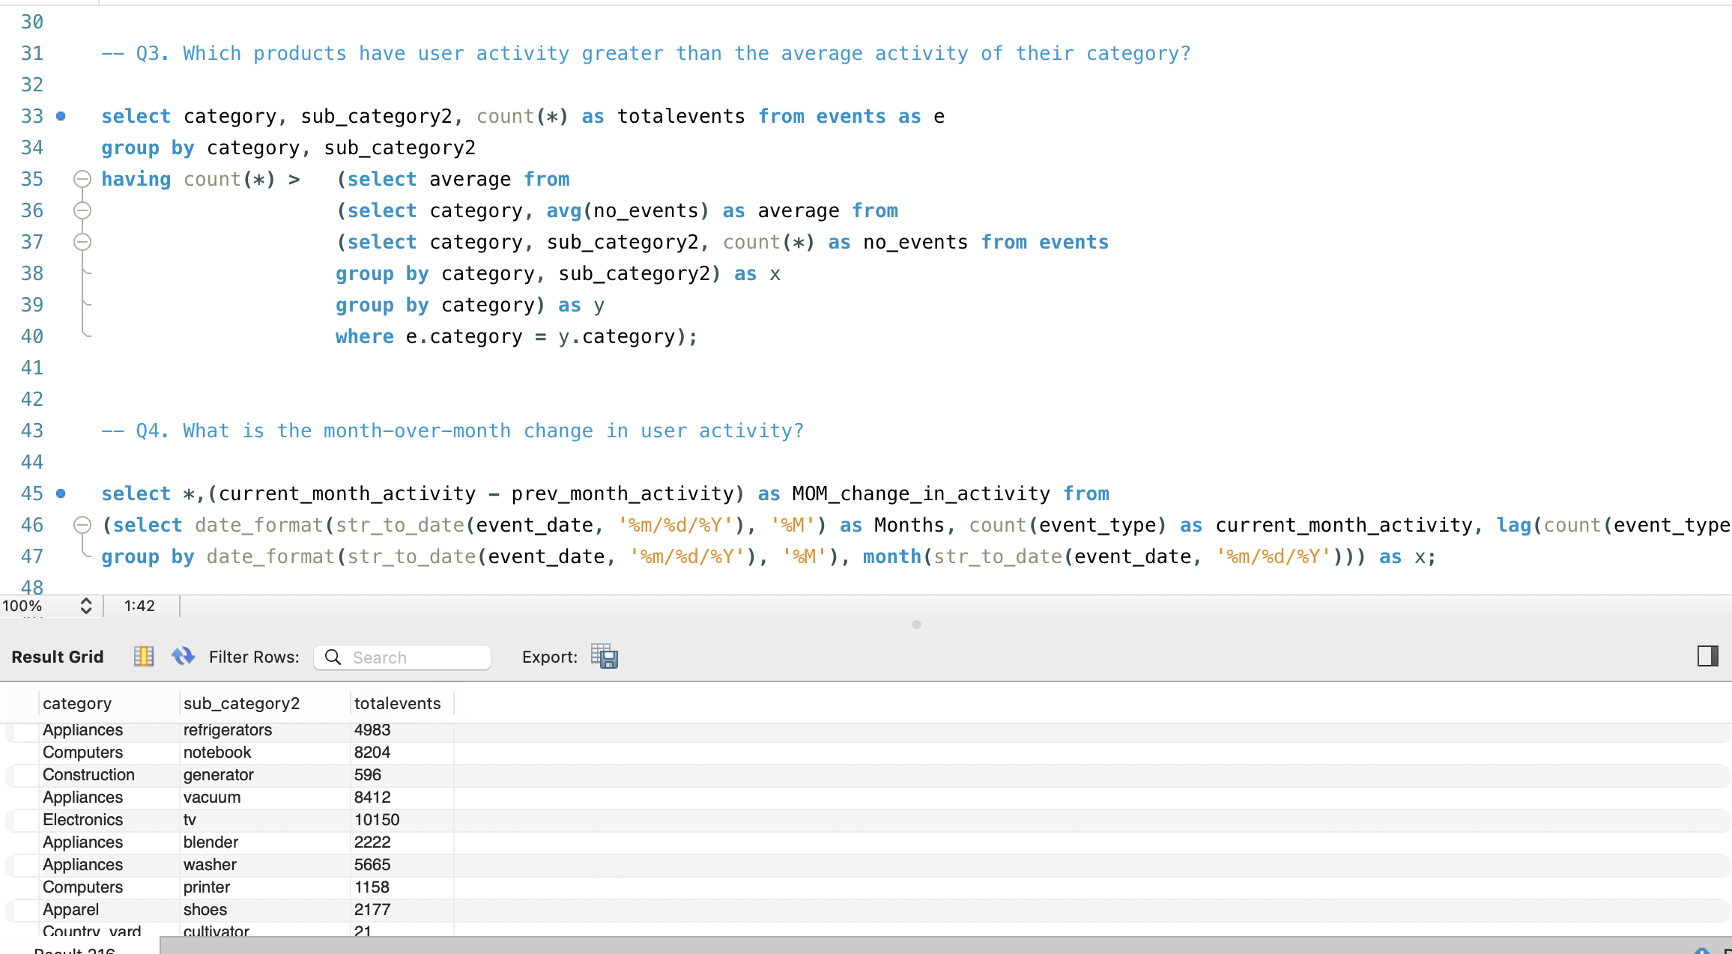
ANALYSIS
MySQL

Slide 10
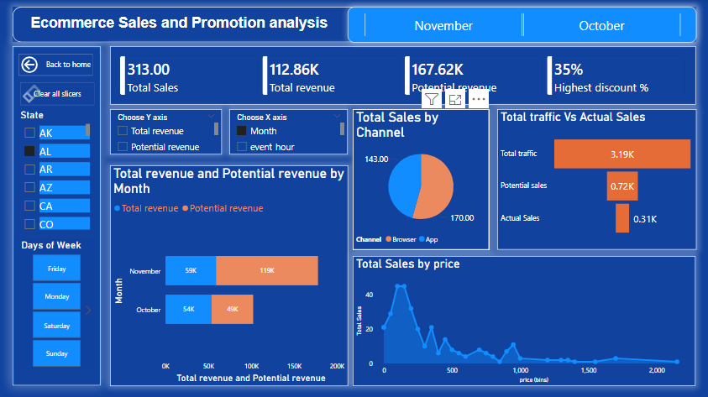
ANALYSIS
POWER BI

Slide 11
KEY FINDINGS
160,000 total events recorded, total unique users are 14335.
Browser leads slightly over App with 80188 events whereas app has 79812 events.
3:00 PM is the peak hour for user activity with 10,317 events.
Georgia (GA) recorded the highest number of user events.
The brand with highest number of user activity is Samsung.
Electronics holds the highest event volume.
Computer is the product (sub_category2) which has the highest average price.
Kids category achieved the highest user score average.

Slide 12
KEY FINDINGS
The highest discount offered in special one-day promotions is 35%.
Product ID 893 had the highest user activity on its promotion date.
Electronics category has the highest Month over month increase in user activity.
Higher discount percentage failed to drive higher engagement.
Product IDs 893 (Apple Smartphone) and 6928 (Redmond Blender) received the maximum 35% discount.
Applying discount doesn’t lead to increase in user activity, most products are showing negligible gains or even significant drops in daily engagement.
Friday is the most active day of the week followed by Saturday whereas Monday has the lowest user interaction.

Slide 13
BUSINESS INSIGHT
Avoid offering large discounts on low-performing products: As per the analysis, higher discounts did not lead to higher user activity. It could be better to offer promotions more selectively, for the products and categories which is already receiving customer’s interest; for products which are added into customer’s cart.
Use engagement analysis to drive conversions: Instead of offering discounts across random products, the business can identify products that show stronger engagement during promotions and can offer discounts on those products which may help in boost sales opportunities.
Focus marketing and engagement activities during peak periods: Since Friday has the highest engagement and 3:00 PM is the peak hour with highest events, the business can run marketing campaigns, product recommendations, and promotional messages during peak period to maximize visibility and engagement.

Slide 14
BUSINESS INSIGHT
Prioritize high-performing categories: Since electronics has the highest engagement volume and the highest month-over-month increase in activity, the business can focus on promoting electronics products and run more campaigns for this category as there are higher chances of sales conversion.
Monitor activity trend for inventory planning: Since Samsung has the highest user activity, the business should keep track of its demand and make sure popular Samsung products are available in the stock to fulfill the orders.
Focus on both channels: Since user activity is similar across browser and app, the business should continue focusing on both channels. Providing a consistent and smooth experience across both platforms can help keep users engaged and support overall business growth.

Slide 15
CONCLUSION
The analysis of e-commerce events provides insights into user activity, product performance, channel preference, and promotional activities. User engagement is balanced between Browser and App. Friday is the day with highest user interaction and 3:00 PM shows the peak time of user activity. Electronics and Samsung recorded highest user activities, while Georgia (GA) had the highest number of events. The analysis also shows that higher discounts did not result in increased user engagement, indicating that only discount percentage may not always lead to higher activity. These insights can help the business in running advertisements and promotions during the peak time, promote the product where customer’s interest is high, keep users engaged on both channels, and make better decisions about promotions and customer engagement.

